Slide 1
NVIDIA GPUs and the CUDA Programming Model
CS 441/541
Winter 2023
Presented by Ali Hassani

Slide 2
Outline
Overview of NVIDIA GPUs and CUDA
Intro to the CUDA programming model
Setting up environment
Live coding a simple kernel
Project 3F

Slide 3
Compute Unified Device Architecture (CUDA)

Slide 4
NVIDIA from 1993-2006
Entered the market with their NV1 release in 1995,
First microprocessor to integrate GUI acceleration, video acceleration, and 3D rendering into a single chip.
Used in Diamond Edge 3D
Made it into desktops and Sega consoles.
Developed their own API and programming model (CUDA) in 2006,
CUDA reduced dependence on Direct3D/OpenGL,
Allowed for non-graphics programmers to write GPU code.
This was a key move towards general-purpose GPUs (GPGPUs).

Slide 5
CUDA: One of the first APIs enabling GPGPUs
Routines such as matrix multiplication, fast Fourier transforms, and decryption algorithms were quickly implemented.
The very fist CUDA toolkit came with cuBLAS: the equivalent of BLAS for CUDA.
Basic Linear Algebra Subroutines (BLAS) is a spec used in most libraries with linear algebra operations (LAPACK, Mathematica, MATLAB, NumPy, R).

Slide 6
CUDA
Typically an extension to C/C++,
Similar to how we did OpenGL projects in C++, but the shaders were in GLSL.
Easy to set up and use,
Gets slightly more complicated if you want to fully take advantage of all the processing power.

Slide 7
CUDA Programming Model
A thread is a stream of instructions and data running on a single “core”

Slide 8
CUDA Programming Model
A thread is a stream of instructions and data running on a single “core”,
A thread block (a.k.a. block, compute thread array [CTA]) is a group of threads that run in parallel.

Slide 9
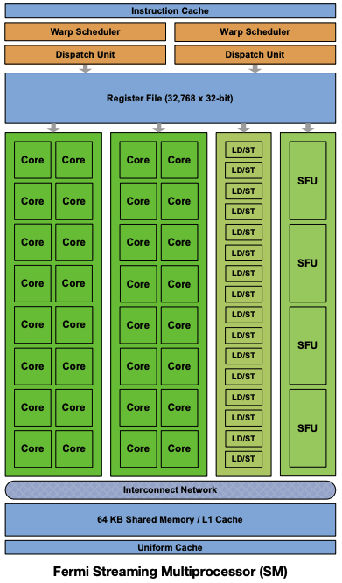
Streaming Multiprocessor (SM)
Every NVIDIA card has a specific number of SMs,
Each SM can run one or more thread blocks (subject to resources requested),
(thread blocks are limited to one SM).
Source: NVIDIA Fermi Whitepaper
Slightly altered for better visualization

Slide 10
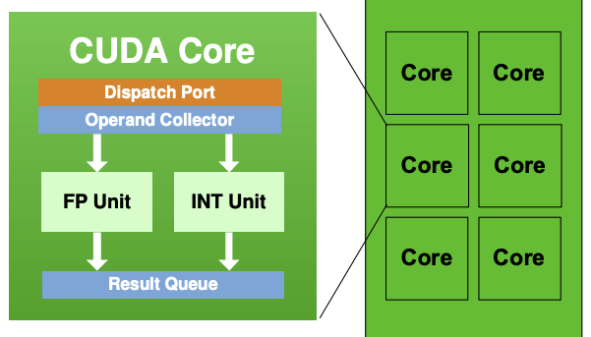
CUDA Cores
CUDA cores typically handle both int and float point operations,
Thread instructions are assigned to one CUDA core.
In other words, every thread occupies a single CUDA core.
Source: NVIDIA Fermi Whitepaper
Slightly altered for better visualization

Slide 11
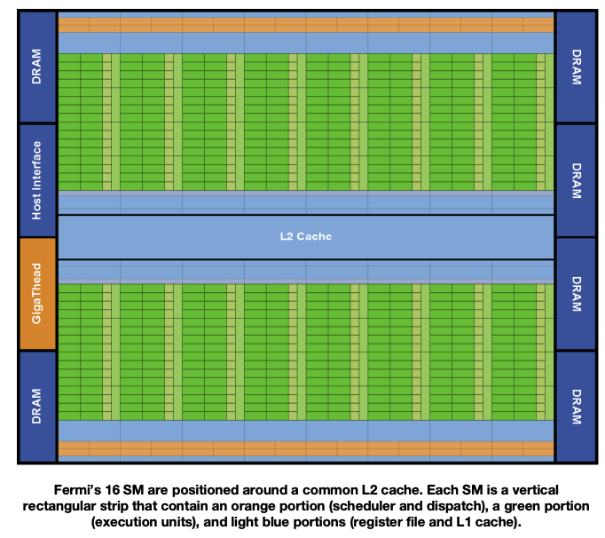
Even more parallelization!
Modern NVIDIA GPUs typically have multiple SMs!
If you have 128 CUDA Cores per SM, and 8 SMs in one GPU, that’s 1024 CUDA Cores total.
1024 FPUs => 1024 FMAs per clock cycle!
Source: NVIDIA Fermi Whitepaper

Slide 12
Question: Which GPU would you pick?
A GPU with
64 CUDA Cores per SM,
32 SMs,
4000 MHz clock speed
A GPU with
128 CUDA Cores per SM,
32 SMs,
2000 MHz clock speed

Slide 13
Question: Which GPU would you pick?
A GPU with
64 CUDA Cores per SM,
32 SMs,
4000 MHz clock speed
A GPU with
128 CUDA Cores per SM,
32 SMs,
2000 MHz clock speed
It depends!

Slide 14
Question: Which GPU would you pick?
A GPU with
64 CUDA Cores per SM,
32 SMs,
4000 MHz clock speed
A GPU with
128 CUDA Cores per SM,
32 SMs,
2000 MHz clock speed
It depends!
What’s the architecture?
What’s the power requirement?
What’s the price?

Slide 15
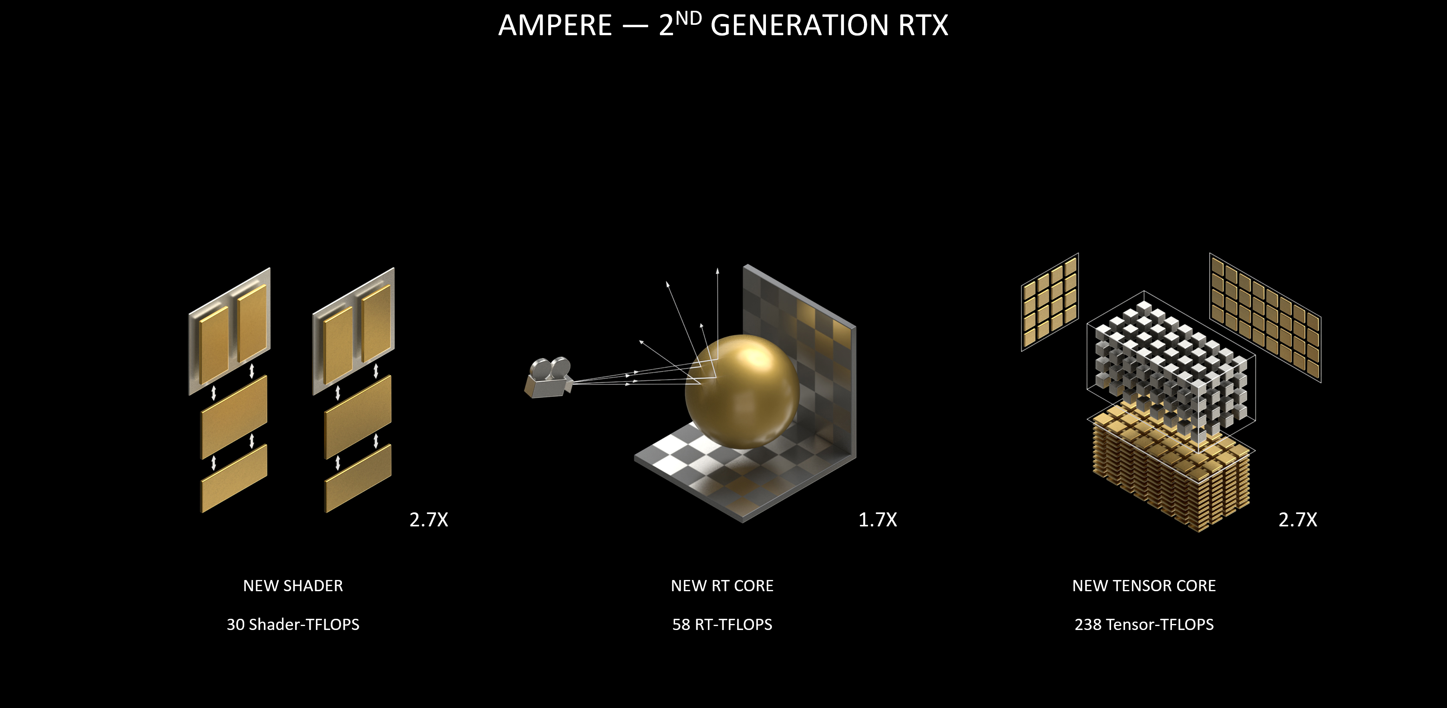
Specialized cores
Source: NVIDIA

Slide 16
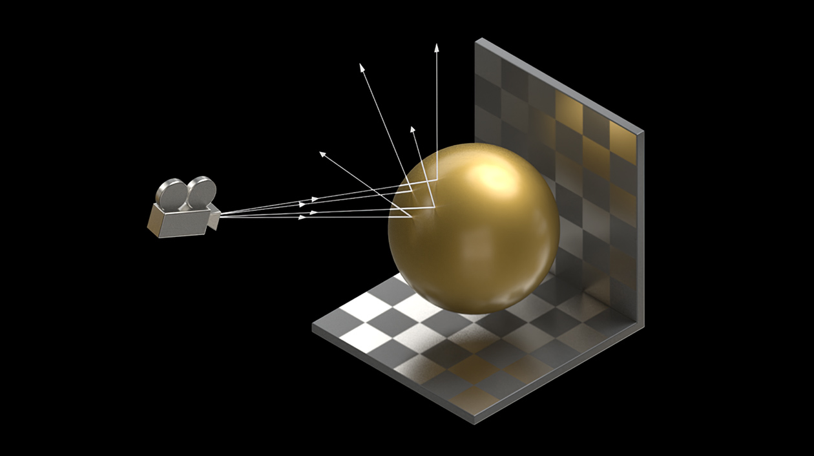
Ray Tracing Cores
Cores dedicated to real-time ray traced renders at high resolution.
Bounding Volume Hierarchy (BVH), Ray-Triangle Intersection, and Denoising are all accelerated by RT cores.
Source: NVIDIA

Slide 17
In AI and Machine Learning
As of 2021, NVIDIA was reported to have an approximately 80% share of “AI processors.”
Tesla GPUs (category not the architecture) are designed for compute servers.
Typically 8 of those cards are packed into a single node, with NVLink-compatible CPUs that provide fast communication between the GPUs.

Slide 18
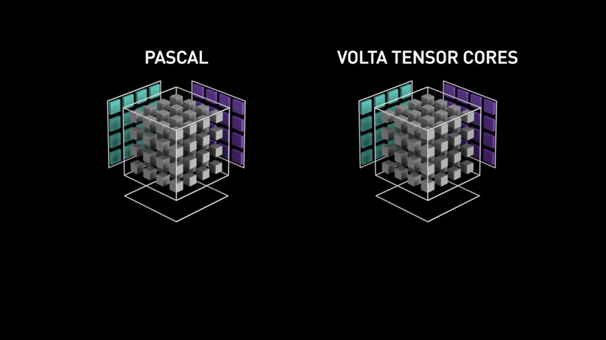
Tensor Cores
Cores dedicated to performing matrix multiply and accumulate (MMAs.)
Volta Tensor Cores perform 64 (4x4x4 matrix multiply and accumulate) FMAs per clock cycle.
Source: NVIDIA

Slide 19
Off topic: how much that can matter
Exactly a year ago, a computer vision model (with ~ 30 M parameters) we were working on in our lab took 9 days to train on ~1.4M images on 8 A100 GPUs (the best server class card available.)
Only a month ago, we trained a slightly more complicated version of that same model in less than a day on the same hardware!

Slide 20
CUDA Programming Model

Slide 21
Heterogeneous Computing
Host: Main processor (CPU)
Host code: CPU instructions (C++)
Host memory: main RAM.
Device: CUDA-compatible device (GPU)
Device code: GPU instructions (CUDA or C++ compiled into CUDA instructions)
Device memory: GPU DRAM (Dynamic RAM)

Slide 22
Steps
We start off at host.
Device memory is allocated.
Data is transferred from host memory to device memory.
Device code is run.
Outputs are transferred from device memory to host memory.
Device memory is freed.

Slide 23
Recall: Shader programs
Main program executes the shader program.
Shader programs are written in GLSL.
Each instance of a shader affects at most a single output pixel.

Slide 24
Recall: 2A Fragment Shader
Fragment shader takes
color,
shading amount;
and produced the final color.
It doesn’t care where the pixel is!
Doesn’t need to know anything about the image.
This makes it highly parallelizable.

Slide 25
Recall: 2A Vertex Shader
Vertex Shader inputs:
Vertex: position, color, normal
Transformations,
Camera: position,
Light: direction, parameters;
Outputs:
shading amount.
Again, highly parallelizable, since it’s independent of the rest of the vertices!

Slide 26
Compute kernels
Compute kernels are sets of instructions that run in parallel on the device.
Shader programs are essentially compute kernels.

Slide 27
Compute kernels
Computer kernels are sets of instructions that run in parallel on the device.
Shader programs are essentially compute kernels.
Instructions are run by multiple threads.

Slide 28
Example
Transform coordinates from world space to camera space, given transformation matrix.
In C++ you’d write:
void transform(double ** points, double ** matrix, double ** new_points, int n_points) {
for (int i=0; i < n_points; ++i) {
for (int j=0; j < 4; ++j) {
new_point[i][j] = 0;
for (int k=0; k < 4; ++k) {
new_point[i][j] += point[i][k] * matrix[k][j];
}
}
}
}

Slide 29
Example
But we want to parallelize as much as we can.
We could have multiple threads, each responsible for a single point:
void transform_point(double * point, double ** matrix, double * new_point) {
for (int j=0; j < 4; ++j) {
new_point[j] = 0;
for (int k=0; k < 4; ++k) {
new_point[j] += point[k] * matrix[k][j];
}
}
}

Slide 30
Example
We could go a step farther and calculate one axis at a time!
void transform_coord(double * coord, double * axis_transform, double * new_coord) {
// We’re referencing by address.
// new_coord and coord are really scalars, not vectors/arrays
new_coord[0] = 0;
for (int k=0; k < 4; ++k) {
new_coord[0] += coord[0] * axis_transform[k];
}
}

Slide 31
These instructions can be repeated
Every X/Y/Z value in every vertex is just multiplied by its corresponding transformation vector.
for (int k=0; k < 4; ++k)
new_coord += coord * axis_transform[k];
Now imagine if we had multiple “cores”, each assigned a specific coordinate in a specific point/vertex.

Slide 32
Question: why aren’t we breaking the last for loop?
Instead of:
for (int k=0; k < 4; ++k)
new_coord += coord * axis_transform[k];
Why aren’t we doing:
new_coord += coord * axis_transform_k;
?

Slide 33
Race condition
Suppose you have 4 threads that update the same location
Some of the changes –will– be inevitably ignored.
This is often referred to as a race condition.
void update(float * vertex, float updt) {
float v = vertex[0];
v += updt;
vertex[0] = v;
}

Slide 34
How are race conditions handled?
Reformulate
Not always possible, not always the best solution
Use atomic operations
Not deterministic, usually slow (subject to algorithm)
Update sequentially
Applicable in very specific cases
Other techniques
There’s more than one way to either avoid a race condition or set up your threads in a way that you prevent them.
You would use atomics in Project 3F to implement z-buffer.

Slide 35

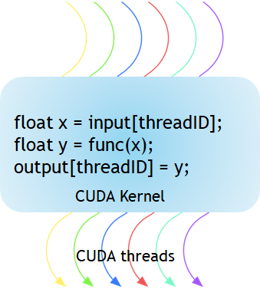
Threads
A thread runs a stream of instructions assigned to a CUDA core.
Source: NVIDIA Developers Blog

Slide 36
Warps
A group of 32 threads that executes the same stream instructions on different data is referred to as a warp.

Slide 37
Warps
A group of 32 threads that executes the same stream instructions on different data is referred to as a warp.
Threads in a warp can synchronize (wait until all reach a certain instruction),
Threads in a warp can communicate (shared memory),
Thread-to-warp assignment is done through the dispatcher (programmers have no control over it.)

Slide 38
Thread blocks
An array of threads that can synchronize and communicate.

Slide 39
Thread blocks
An array of threads that can synchronize and communicate.
Shared memory is on-chip (SM) memory,
Faster than both local and global memory,
Shared across all threads in a thread block

Slide 40
Thread blocks
An array of threads that can synchronize and communicate.
Shared memory is on-chip (SM) memory,
Faster than both local and global memory,
Shared across all threads in a thread block
Maximum of 1024 threads per thread block.

Slide 41
Why would we need synchronization? Doesn’t that affect parallelism?

Slide 42
Why would we need synchronization? Doesn’t that affect parallelism?
Well; not as much as you think.
Memory-bound problems: accessing global memory (DRAM) can be slower than your SM can perform float or int ops!

Slide 43
Why would we need synchronization? Doesn’t that affect parallelism?
Well, not as much as you think.
Memory-bound problems: accessing global memory (DRAM) can be slower than your SM can perform float or int ops!
Because shared memory is on-chip, it’s noticeably faster (in optimal scenarios, roughly 100x compared to uncached global memory reads.)
As a result you’d want to read once, store in shared memory, operate, and write once.

Slide 44
Grids
A grid is the set of all thread blocks associated with a kernel launch.

Slide 45
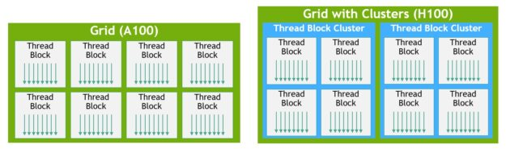
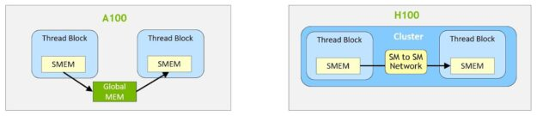
Clusters (New in the Hopper architecture)
Source: NVIDIA Developers Blog
Threadblock-to-threadblock communication (SM-to-SM.)
Thread block clusters are introduced in CUDA v12 (GTC 2022)
Source: NVIDIA Developers Blog

Slide 46
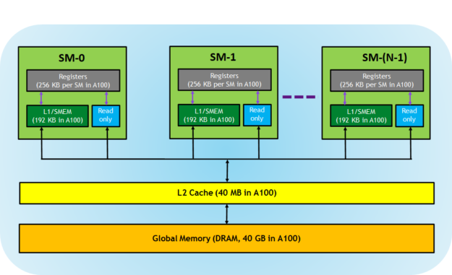
Memory hierarchy
Register file feeds directly into CUDA cores.
Shared memory can be written to / read from directly.
L1 cache may cache global memory reads and/or serve as overflow memory for registers.
Constant cache (read only) holds constants broadcast to all threads.
Source: NVIDIA Developers Blog

Slide 47
Typical kernel structure
Read from global memory, store in shared memory
Synchronize
Main loop (compute output(s))
(Sometimes) Synchronize
Update output in global memory.

Slide 48
Writing kernels
Can be as straightforward or complicated as you’d like.
Kernels are defined with the __global__ decorator.
__global__ void mykernel() {
// instructions
}

Slide 49
Writing device functions
Device functions are defined with the __device__ decorator.
The difference between kernels and other device functions is that kernels are the “main” program (they can be configured…)
__device__ void myfunction() {
// instructions
}

Slide 50
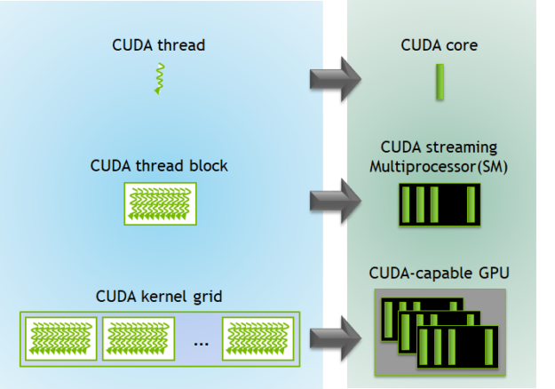
Configuring kernels
Kernels require resources, such as:
Number of thread blocks (grid size)
Number for threads per block (block size)
Shared memory size
And other properties, such as:
CUDA stream
Source: NVIDIA Developers Blog

Slide 51
Naive configuration
Given problem size N (size of your output):
Launch your kernel with N thread blocks, each with 1 thread.
Occupies min(S, N) SMs (total S)
Each only with a single thread (of 1024 max)

Slide 52
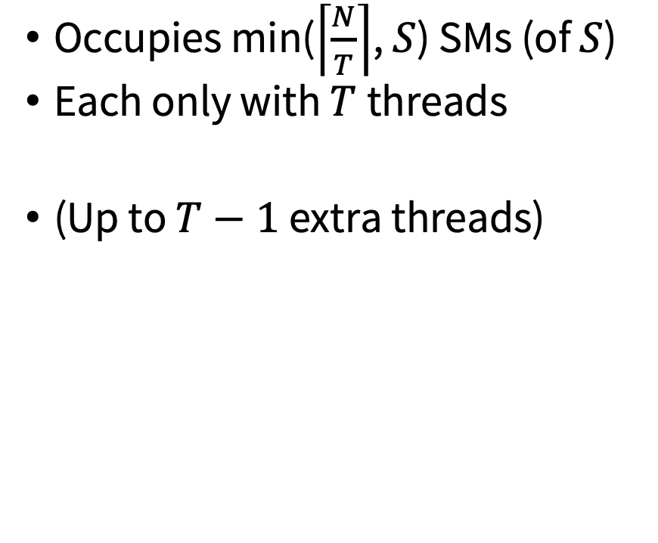
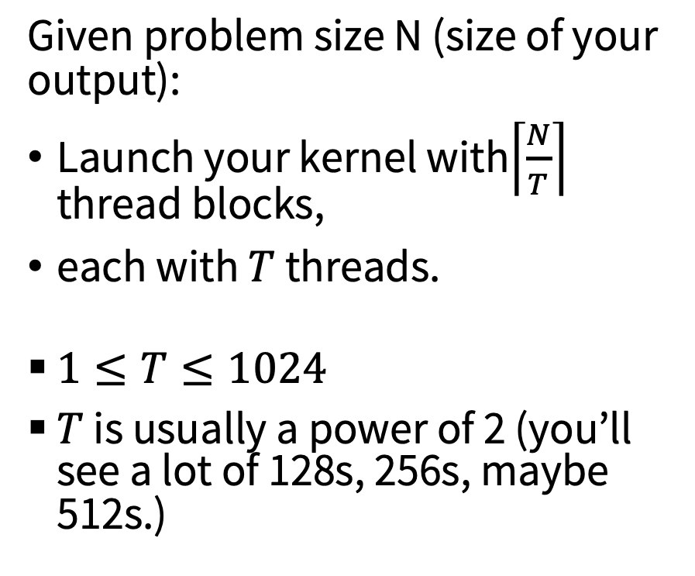
“Go-to” configuration
Given problem size N (size of your output):
Launch your kernel with$\left\lceil \frac{N}{T}\right\rceil$ thread blocks,
each with $T$ threads.
$1≤T≤1024$
$T$ is usually a power of 2 (you’ll see a lot of 128s, 256s, maybe 512s.)
Occupies min($\left\lceil \frac{N}{T}\right\rceil$, $S$) SMs (of $S$)
Each only with $T$threads
(Up to $T−1$ extra threads)

Slide 53
Why not always do the 1024 threads?
Shared memory limit
There’s only 48KB memory available per SM
Register limit
Basically any limit in resources.

Slide 54
Okay, let’s launch our kernel
Let’s launch mykernel with 2 blocks of 4 threads each.
mykernel<<<2, 4>>>();
__global__ void mykernel() {
// instructions
}

Slide 55
That’s it!
This is how you launch every kernel.
KernelName<<<BLOCKS, THREADS>>>(ARGUMENTS);
We’re not going to worry about shared memory and stream in this lecture.
But if you’re interested, do let me know.

Slide 56
One other cool thing about CUDA
You can have print statements and assertions!
__global__ void mykernel() {
printf("Hello from block %d, thread %d\n", blockIdx.x, threadIdx.x);
}

Slide 57
Notes
Kernels are run asynchronously
This means that the CPU will continue to run host instructions that follow the kernel launch.
You can force it to wait until the kernel launch finishes:
cudaDeviceSynchronize();

Slide 58
Notes
2. CUDA errors do not interrupt host process.
This means that the CPU will continue to run host instructions whether or not kernel launch succeeds!
You can manually check if there were errors:
cudaDeviceSynchronize();
cudaError_t result = cudaGetLastError(); printf(cudaGetErrorString(result));

Slide 59
Notes
2. CUDA errors do not interrupt host process.
This means that the CPU will continue to run host instructions whether or not kernel launch succeeds!
Or just use this function from Lei Mao’s blog (included in the 3F starter code):
CHECK_LAST_CUDA_ERROR();

Slide 60
Notes
3. Memory allocation in kernels is tricky!
You can do 3F without having to use malloc/free within a kernel, and it is strongly recommended!
But just for your information, within device code you should use just the normal malloc and free functions, and not cudaMalloc and cudaFree.

Slide 61
Compiling your code

Slide 62
NVCC: CUDA Compiler
Instead of g++ projG.cxx
Run nvcc projG.cu
You can compile programs with no device code!

Slide 63
NVCC: CUDA Compiler
Instead of g++ projG.cxx
Run nvcc projG.cu
You can compile programs with no device code!
It only interprets and compiles device functions as CUDA syntax.
The rest is just C++.

Slide 64
Useful tools

Slide 65
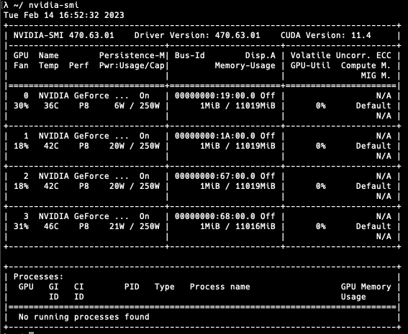
NVIDIA-SMI: monitor GPU usage
Just a useful tool that usually comes with CUDA toolkit.
Shows you GPUs, processes using them, and statistics such as utilization, memory usage, and power usage.

Slide 66
NVIDIA-SMI: monitor GPU usage
Do NOT take its reported CUDA version for granted!
If you want to check the CUDA compiler version, do: nvcc --version

Slide 67
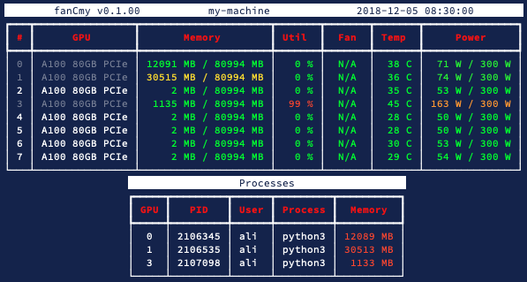
Advertisement: try my SMI interface
pip install fancy-smi
And then just run `fancy-smi`!
It talks to `nvidia-smi` and gets GPU statistics in CSV, and pretty prints them.

Slide 68
Advertisement: try my SMI interface
Watch mode:
fancy-smi -r 1
Refresh every 1 second.

Slide 69
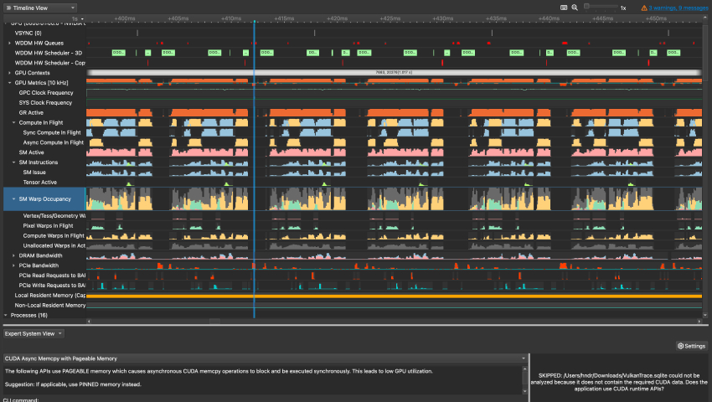
Nsight: Profile your CUDA code

Slide 70
Where do I get NVIDIA GPUs?

Slide 71
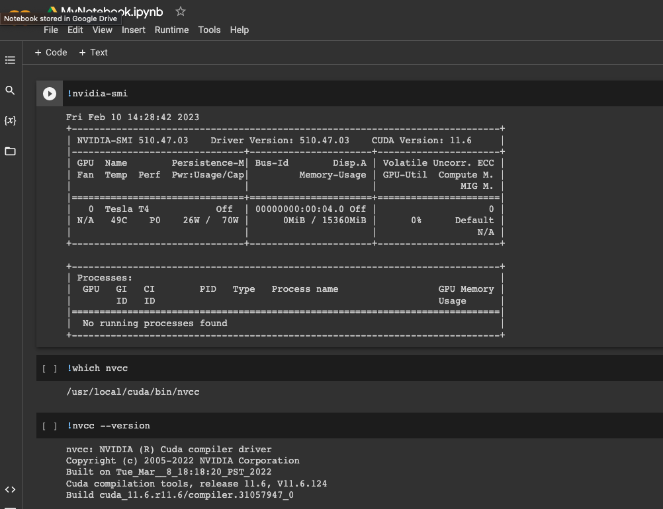
Google Colab?
Gives you free GPU access with the CUDA compiler, but your access is limited to 12 hours.
And it’s an IPython environment, meaning you have to get used to overriding it when you want to access the terminal.

Slide 72
TBA: Resources from UO / CIS research groups?

Slide 73
Let’s write a hello world kernel!

Slide 74
Project 3F: CUDA

Slide 75
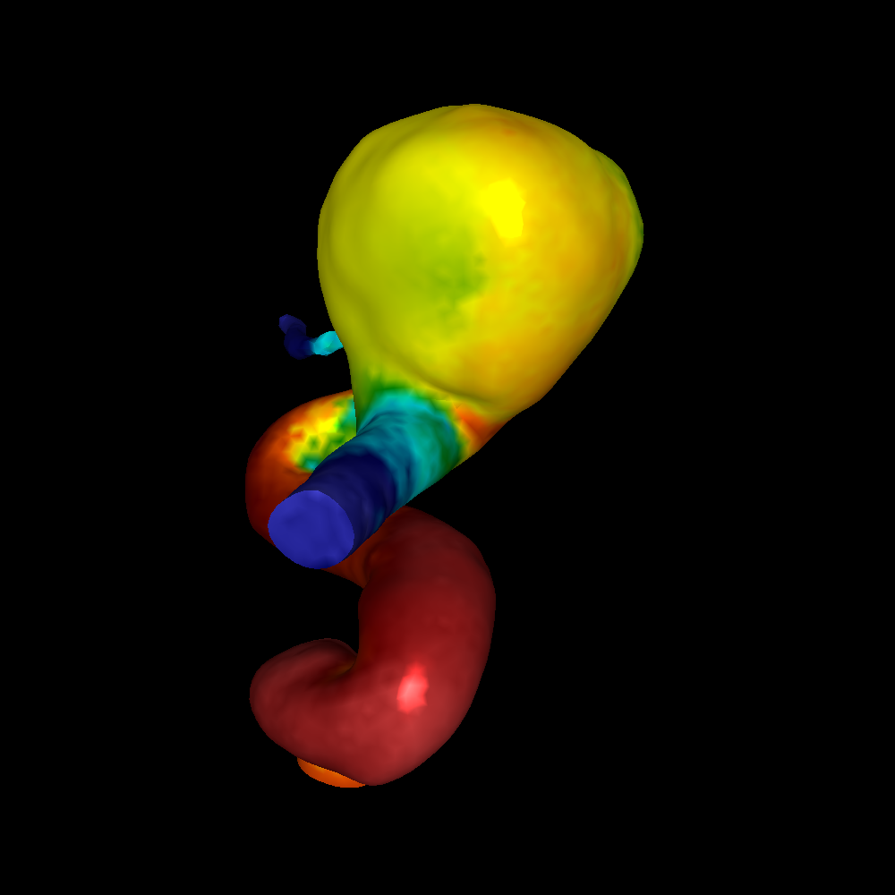
Project 3F: Redo 1F in CUDA!
Read triangles into device memory and allocate a device Image

Slide 76
Project 3F: Redo 1F in CUDA!
2. For every frame:
Set up camera,
Get lighting parameters based on camera
[DEVICE] Run Phong shading
[DEVICE] Transform coordinates from world space to device space (device being screen, not to be confused with GPU device)
[DEVICE] Rasterize,
Copy image from device to host memory and save as PNM.
NOTE: Please make this a single function, because in order to measure rasterization speed, we will have to comment this out.

Slide 77
Data
It’s the same old ws_tris.txt from 1E and 1F.
No change required to that file.
The reader function in the starter code was adapted slightly to read, and immediately write vertices to device memory.

Slide 78
Starter Code

